Slide 1

Department of Computer Science and Engineering
HYBRID DEEP LEARNING MODEL USING RESIDUAL ATTENTION AND BILSTM FOR ACCURATE ISCHEMIC HEART DISEASE CLASSIFICATION
PRESENTED BY
Bhavana Vatram (22471A05D7)
Azhar Shaik Mothad (22471A05D2)
Afreen Neha Shaik (22471A05C7)
Under the Guidance of,
Gayatri Panchumarthi
Department of Computer Science and Engineering,
Narasaraopeta Engineering College (Autonomous),
Narasaraopet- 522 601.

Slide 2

OUTLINE
Abstract
Introduction
Literature Survey
Research Gaps
Problem Statement
Objectives
Block Diagram / Flow Diagram
Methodology
Results and Analysis
Conclusion & Future Scope
References
Acknowledgements.

Slide 3

ABSTRACT
Ischemic heart disease (IHD) is a major global health concern, creating a strong need for accurate and reliable diagnostic systems. This study introduces a deep learning model called HRAE–LSTM to improve early prediction of IHD using patient health data. The model integrates residual attention mechanisms with Bidirectional LSTM layers, allowing it to analyze data in both forward and backward directions and learn complex patterns effectively. An attention mechanism helps focus on the most relevant features, improving interpretability for medical decision-making.Missing values in the dataset are handled using K-Nearest Neighbors (KNN) imputation, which estimates missing data by identifying similar patient records.

Slide 4
ABSTRACT
The model is trained using the UCI Heart Disease dataset containing 14 important clinical attributes such as age, blood pressure, cholesterol, and maximum heart rate. To handle class imbalance and ensure reliable evaluation, SMOTE-ENN and stratified cross-validation techniques are applied.
The proposed HRAE–LSTM model achieves 98.9 percent accuracy with an AUC score of 1.00, outperforming traditional machine learning methods such as Random Forest, SVM, AdaBoost, and deep learning models like CNN-GRU, showing strong potential for real-world clinical diagnosis of ischemic heart disease.

Slide 5

INTRODUCTION
Ischemic heart disease (IHD) remains the most common heart-related condition and a leading cause of global mortality, responsible for over 17.9 million deaths each year. It occurs when coronary arteries become narrowed or blocked, reducing blood flow to the heart muscle and leading to serious complications such as myocardial infarction and chronic heart failure. Early and accurate diagnosis is essential to reduce mortality and improve treatment outcomes.
Conventional diagnostic techniques such as electrocardiograms, stress tests, and coronary angiography are widely used in clinical practice. However, these methods are expensive, require specialized equipment, and are not suitable for large-scale screening, particularly in underdeveloped regions.

Slide 6
INTRODUCTION
Recently, artificial intelligence-based approaches have gained attention for diagnosing heart-related conditions due to their speed, scalability, and cost-effectiveness. Despite their potential, real-world clinical datasets often suffer from challenges such as missing values, class imbalance, and feature scaling, which can negatively impact model performance. Effective data preprocessing is therefore crucial for reliable prediction.
Missing data can be addressed using K-Nearest Neighbors imputation, while normalization improves training efficiency by scaling features uniformly. Class imbalance is handled using SMOTE-ENN, and stratified five-fold cross-validation ensures unbiased and reliable evaluation.
To overcome limitations in existing models, the proposed work introduces a hybrid deep learning approach that integrates residual attention layers with Bidirectional LSTM to enhance predictive accuracy and interpretability in ischemic heart disease diagnosis.

Slide 7

LITERATURE SURVEY
1. Deep Learning and Hybrid Models for Heart Disease Prediction
Recent research has applied deep learning and hybrid models for ischemic heart disease (IHD) prediction. Cenitta et al. (2020) introduced HRAE-LSTM, combining LSTM with residual attention, achieving 97.71% accuracy on UCI data, though it relied on extensive labeled datasets.
Garcia-Ordas et al. (2019) used CNN-SAE for 90.09% accuracy but with limited features. Dritsas and Trigka (2019) applied CNN-GRU hybrids, facing dataset size limitations. Sahu et al. (2020) leveraged attention-based networks with active learning, while Xu et al. (2020) proposed CardioRiskNet for high accuracy but limited validation. Zhou et al. (2018) highlighted CNN, LSTM, and hybrid models, noting gaps in attention and missing data handling.

Slide 8
LITERATURE SURVEY
2. Challenges in Clinical Data and Model Limitations
Clinical datasets for heart disease prediction face missing data, class imbalance, and complex temporal dependencies. KNN imputation preserves intrinsic data relationships, while SMOTE+ENN balances minority and majority classes, improving model sensitivity. Attention mechanisms, particularly residual attention layers, highlight critical features for interpretability.
BiLSTM networks capture forward and backward temporal relationships, modeling complex interactions. Hybrid models combining CNNs, LSTM/GRU, and attention outperform single architectures by extracting spatial, temporal, and weighted feature representations. Stratified k-fold cross-validation ensures unbiased evaluation, with metrics like accuracy, AUC, precision, recall, specificity, and F1-score providing comprehensive performance assessment.

Slide 9
LITERATURE SURVEY
3. Gaps and Motivation for HRAE-LSTM
Existing models face limitations in interpretability, generalizability, reliance on labeled data, and handling missing values or class imbalance. Temporal feature extraction is often underutilized.
HRAE-LSTM addresses these gaps using residual attention layers to prioritize key features, BiLSTM to capture temporal dependencies, KNN for missing data imputation, and SMOTE+ENN to balance datasets. Stratified 5-fold cross-validation ensures robust evaluation.
This hybrid framework achieves 98.9% accuracy and 1.00 AUC on the Cleveland dataset, outperforming SVM, Random Forest, and AdaBoost, while offering clinical relevance, interpretability, and potential for IoT-enabled or edge-based healthcare applications.

Slide 10
RESEARCH GAPS
Evaluation is limited to a single small dataset, increasing overfitting risk and weakening generalization. The study lacks calibration analysis, uncertainty estimation, and subgroup fairness evaluation, which are essential for clinical trust.
Interpretability relies only on attention maps, without complementary explainability methods. No ablation studies or reproducibility details are provided.
The use of BiLSTM for static features is unclear, and robustness, cost effectiveness, and real world deployment feasibility remain untested across diverse healthcare settings globally and clinical environments.

Slide 11
RESEARCH GAPS
Future work should emphasize validation across multiple diverse datasets to ensure generalization. Advanced explainability techniques such as SHAP should complement attention mechanisms for clearer clinical insight.
Calibration metrics, uncertainty quantification, and fairness checks across demographics must be included.
Efficiency, robustness, and cost effectiveness analyses are needed for deployment.
Testing on real world clinical data will strengthen reliability and support practical adoption of the proposed HRAE LSTM model in future clinical decision support systems worldwide and hospital settings.

Slide 12
PROBLEM STATEMENT
Problem Background
Ischemic heart disease (IHD) is a major cause of global mortality, occurring due to reduced blood flow to the heart from arterial blockages. Early and accurate diagnosis is essential to prevent severe complications and improve patient outcomes.
However, conventional diagnostic techniques such as electrocardiograms (ECG), angiography, and stress tests are expensive, time-consuming, and require specialized medical infrastructure.
These limitations make them impractical for large-scale population screening, especially in resource-constrained settings, highlighting the need for efficient, cost-effective, and scalable diagnostic approaches.

Slide 13
PROBLEM STATEMENT
Problem Statement
Existing machine learning models for ischemic heart disease prediction face challenges such as handling missing clinical data, class imbalance, and poor interpretability of results.
These limitations reduce their reliability and acceptance in clinical practice. As a result, there is a strong need for an advanced deep learning framework that is accurate, robust, and explainable.
Such a model should effectively manage incomplete data, ensure balanced prediction performance, and provide transparent decision insights to support trustworthy and clinically meaningful ischemic heart disease classification.

Slide 14
OBJECTIVES
Main Objective
The primary objective of this research is to develop an efficient, accurate, and interpretable deep learning framework, termed HRAE–LSTM, for ischemic heart disease classification.
The model integrates Residual Attention mechanisms with Bidirectional Long Short-Term Memory (BiLSTM) layers to capture complex feature interactions and emphasize clinically significant patterns.
By combining attention and residual learning, the framework aims to improve predictive performance while maintaining transparency in decision-making, supporting early and reliable diagnosis of ischemic heart disease in clinical environments.

Slide 15
OBJECTIVES
Specific Objectives
The study seeks to address common challenges in medical datasets by applying K-Nearest Neighbors (KNN) imputation to manage missing values and using the SMOTE–ENN technique to handle class imbalance.
Feature standardization is employed to ensure stable and optimized learning during training. Another key objective is to perform a comprehensive performance comparison between the proposed HRAE–LSTM model and existing machine learning and deep learning methods.
This evaluation aims to validate the robustness, accuracy, and reliability of the proposed framework, ensuring its practical applicability and effectiveness for real-world clinical diagnosis and decision support systems.

Slide 16
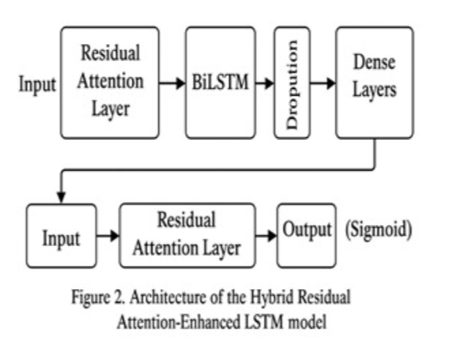
BLOCK DIAGRAM OR FLOW DIAGRAM

Slide 17
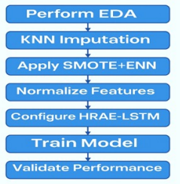
METHODOLOGY
A. Dataset Description
The study employs the widely used Cleveland heart disease dataset, containing medical records of 303 individuals described by 14 clinical and demographic attributes. Key continuous features include age, sex, resting blood pressure, cholesterol level, and maximum heart rate achieved during exercise. Categorical attributes include chest pain type, fasting blood glucose, ECG results, exercise-induced angina, and ST segment slope. The dataset also includes thal and fluoroscopy data. The target variable “num” indicates coronary artery disease severity on a scale of 0 to 4.
Block Diagram for Complete Workflow

Slide 18
METHODOLOGY
B. Data Preprocessing
Before applying deep learning techniques, the dataset required extensive preprocessing to ensure high quality and reliability. This process addressed common clinical data issues such as missing values, sparse classes, and inconsistent feature dimensions.
1.Preliminary data analysis:
It was first conducted to identify and remove anomalies, outliers, and abnormal values. Boxplots and heatmaps were used to compare features and understand data distribution.
The dataset was also examined for class imbalance in cardiac disease detection, where non-cardiac cases significantly outnumbered cardiac cases. If left unhandled, this imbalance could negatively affect model accuracy and predictive performance.

Slide 19
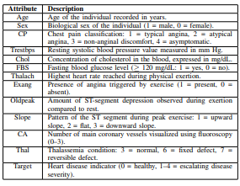
METHODOLOGY
Preliminary data analysis ensured data reliability by identifying missing values, outliers, and inconsistencies. Visualization techniques helped understand feature distributions and relationships, supporting better preprocessing decisions and improving overall model performance in cardiac disease prediction tasks.
Detailed Attribute Description of the Heart Disease Dataset

Slide 20
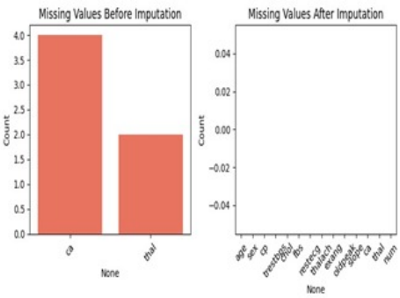
METHODOLOGY
2. Filling Missing Values Using the KNN Method:
Missing values in key variables such as thal and ca were handled using the K-Nearest Neighbors imputation method with k=5.
This technique replaces missing entries by averaging values from the five most similar records, helping preserve underlying data relationships and improving prediction accuracy compared to simple mean or median imputation approaches.
missing data both before and after imputation.

Slide 21
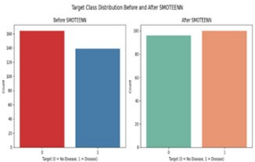
METHODOLOGY
3. Addressing Class Imbalance with SMOTE + ENN:
The dataset suffered from class imbalance, as “no disease” cases were more frequent than “disease” cases. This imbalance could cause models to favor the majority class and miss true disease instances.
To overcome this issue, the SMOTE+ENN technique was applied to generate a cleaner, more balanced training dataset, thereby improving heart disease detection performance, including rare cases.
4.Final Output of Preprocessing:
After preprocessing with KNN imputation, SMOTE+ENN, and standardization, the balanced dataset was ready for efficient HRAE-LSTM training and accurate heart disease prediction.
Class Distribution Before and After SMOTEENN

Slide 22
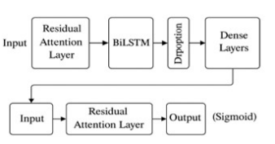
METHODOLOGY
C. Model Architecture & Training
1. Feature Scaling Using Standard Scaler:
The dataset features were standardized using the Standard Scaler to ensure equal contribution during training.
The HRAE-LSTM model uses residual attention layers and BiLSTM to capture important features and temporal dependencies.
Dropout and dense layers improve generalization, while sigmoid activation outputs ischemic heart disease probability for binary classification.
Design of the HRAE-LSTM Model Using Residual
Attention and Bidirectional LSTM

Slide 23
METHODOLOGY
D. Model Training and Testing
To evaluate the robustness and accuracy of the HRAE-LSTM model, five-fold cross-validation was performed.
The dataset was divided into five equal subsets, where four folds were used for training and one for testing in each iteration.
This process was repeated five times so every data sample appeared in the test set once, and final results were averaged to reduce bias.
Early stopping was applied to prevent overfitting by halting training when validation accuracy stopped improving.
Model performance was assessed using baseline classification accuracy and the Area Under the ROC Curve (AUC), ensuring an unbiased and reliable evaluation.

Slide 24
FRAMEWORK USED - HRAE–LSTM
Input Phase
Processes normalized clinical data.
Residual Attention Module
Extracts key features while preserving original context.
Bidirectional LSTM
Captures bidirectional dependencies among patient attributes.
Classification & Evaluation
Dense layers with sigmoid output classify disease; validated using stratified cross-validation, achieving 98.9% accuracy and AUC = 1.00.

Slide 25
Implementation
The proposed HRAE–LSTM model was implemented using the Cleveland heart disease dataset.
Preprocessing included KNN imputation for missing values, SMOTE+ENN for class balancing, and standard scaling for feature normalization.
The model architecture integrated residual attention layers with a BiLSTM network to capture important clinical features and temporal dependencies.
Training was performed using stratified five-fold cross-validation with early stopping to prevent overfitting.
Model performance was evaluated using accuracy and AUC metrics, ensuring reliable and unbiased results.

Slide 26
System Requirements
Hardware Requirements
Processor : Intel Core i5 or higher
RAM : 8 GB minimum
Hard Disk : 100 GB free space
GPU : NVIDIA T4 or equivalent
Software Requirements
OS : Windows 10 / 11 (64-bit)
Language : Python 3.8+
IDE : Google Colab / Jupyter Notebook
Libraries : TensorFlow, Keras, Scikit-learn, Pandas
Browser : Latest Google Chrome

Slide 27
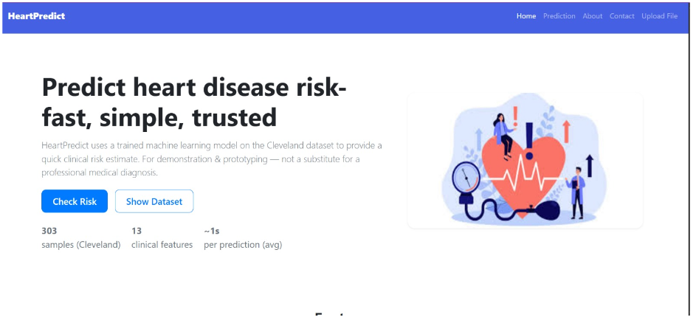
Implementation of Frontend

Slide 28
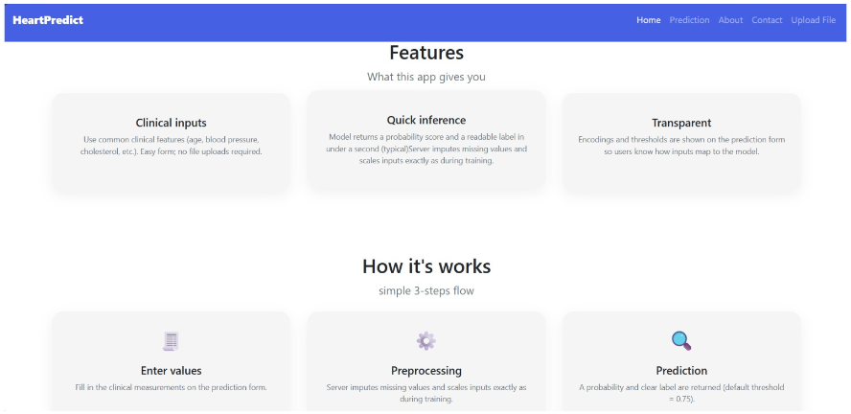
Implementation of Frontend

Slide 29
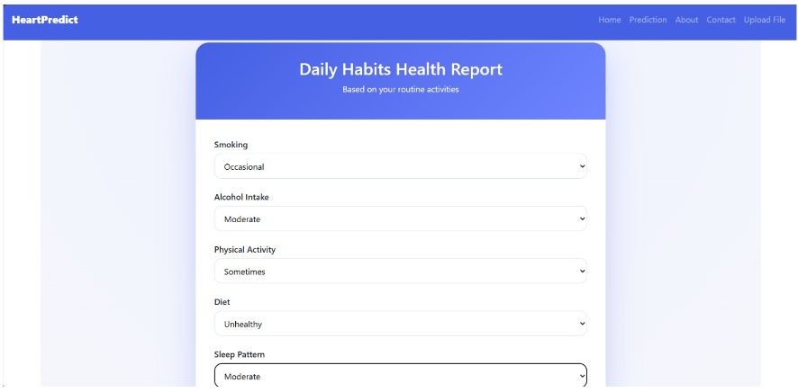
Implementation of Frontend

Slide 30
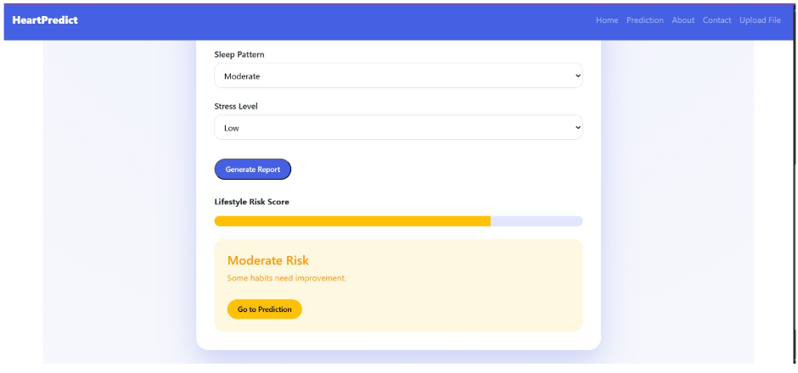
Implementation of Frontend

Slide 31
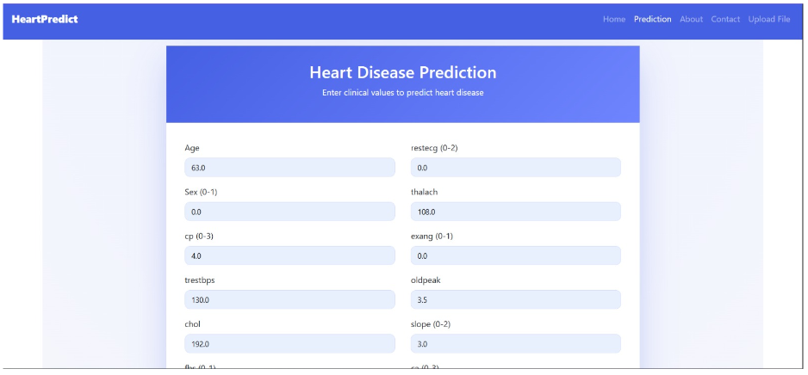
Implementation of Frontend

Slide 32
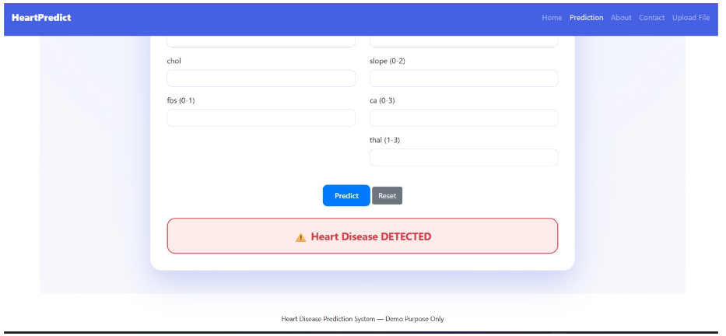
Implementation of Frontend

Slide 33
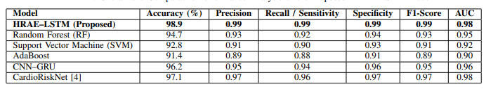
RESULTS & ANALYSIS
HRAEOverall and Comparative Performance Analysis of the Proposed –LSTM Model

Slide 34
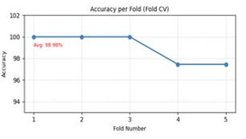
RESULTS & ANALYSIS
The HRAE–LSTM model, evaluated
Using stratified5-fold cross-validation, showed consistent accuracy across all folds with minimal variation,
demonstrating strong generalization,
stability, and reliability for real-world
clinical deployment in ischemic heart
disease prediction. Accuracy achieved in each fold of the 5-fold stratified cross-validation.

Slide 35
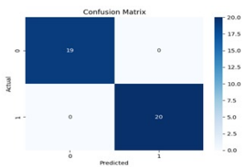
RESULTS & ANALYSIS
The confusion matrix shows perfect classification with no false positives or negatives, achieving 100% accuracy.
This indicates excellent model performance, though it may also suggest possible overfitting or dataset simplicity.
Accuracy achieved in each fold of the 5-fold stratified cross-validation.

Slide 36
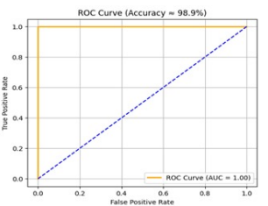
RESULTS & ANALYSIS
The ROC curve shows excellent discrimination between diseased and healthy cases, with the curve near the top-left corner.
The model achieved an AUC of 1.00 and 98.9% accuracy, indicating near-perfect classification performance.
ROC Curve of the HRAE–LSTM model showing True Positive Rate vs. False Positive Rate.

Slide 37
CONCLUSION & FUTURE SCOPE
CONCLUSION
The HRAE–LSTM model achieved 98.9% accuracy and AUC = 1.00, outperforming traditional models by effectively handling missing data, class imbalance, and complex clinical feature dependencies.
FUTURE SCOPE
Future work includes integrating the model into IoT-based devices for real-time monitoring, enhancing explainability (SHAP), applying federated learning, and improving computational efficiency for deployment.

Slide 38
REFERENCES
[1] G. A. Roth, “Global burden of cardiovascular diseases and risk factors, 1990–2019: Update from the gbd 2019 study,” Journal of the American College of Cardiology, vol. 76, no. 25, pp. 2982–3021, Dec. 2020.
[2] C. H. Lam, J. Y. Liu, and M. T. Cheung, “A global perspective on the economic evaluation of coronary artery disease diagnosis in low-resource settings,” Health Policy and Technology, vol. 12, no. 1, pp. 55–64, Mar 2023.
[3] E. Dritsas and M. Trigka, “A convolutional recurrent neural network (cnn-gru) framework for clinical heart disease classification,” IEEE Access, vol. 10, pp. 83 290–83 303, 2022.
[4] Y. Xu, R. Wang, J. Zhang, and H. Chen, “Cardiorisknet: A lightweight attention-based model for predicting cardiovascular risk,” Computers in Biology and Medicine, vol. 155, p. 106556, 2023.
[5] H. Zhou, B. Wang, and M. Yang, “A comprehensive review of deep learning architectures for diagnosing cardiovascular diseases,” IEEE Reviews in Biomedical Engineering, vol. 16, pp. 17–32, 2023.
[6] H. R. Mohan, “A comparative study of imputation techniques for missing data in medical datasets,” Biomedical Signal Processing and Control, vol. 61, 2020.
[7] D. Ria, S. Sharma, and P. Gupta, “Effectiveness of standard scaling for enhancing machine learning prediction accuracy in cardiovascular datasets,” Processes, vol. 11, no. 4, pp. 1–12, Apr. 2023.
[8] J. E. Steyerberg and J. P. A. Ioannidis, “Internal validation: split sample, cross validation, and bootstrap,” in Clinical Prediction Models. Springer, 2023, ch. 17, pp. 325–347.
[9] D. Cenitta, S. F. Cracolici, and A. C. Vitabile, “A residual attention and lstm-based deep hybrid architecture for ischemic heart disease classification,” Multimedia Tools and Applications, vol. 82, pp. 31 323–31 347, 2023.

Slide 39
REFERENCES
[10] M. T. Garc´ıa-Ordas, L. Benedi, J. C. G. Alonso, and C. L. Gonz ´ alez, “Heart failure detection using convolutional neural networks combined with stacked autoencoders,” Biomedicines, vol. 11, no. 1, p. 64, Jan. 2023.
[11] D. Sahu, S. Panda, S. S. Shinde, A. Singh, and S. Pandey, “Deep learning with attention mechanisms for cardiovascular disease detection,” Applied Intelligence, 2025, [Online]. Available: https://link.springer.com/article/10.1007/s10462-024-10899-9.
[12] D. Dua and C. Graff, “Heart disease data set,” 2019, uCI Machine Learning Repository, University California, Irvine. [Online]. Available: https://archive.ics.uci.edu/ml/datasets/Heart+Disease.
[13] M. Elreedy, M. Elhoseny, and A. Hassanien, “A combined smote and enn technique to handle class imbalance for heart disease prediction,”Sensors, vol. 23, no. 1, p. 110, Jan. 2023.
[14] S. Sunayna, S. Rao, and M. Sireesha, “Performance evaluation of machine learning algorithms to predict breast cancer,” in Computational Intelligence in Data Mining, ser. Smart Innovation, Systems and Technologies, J. Nayak, H. Behera, B. Naik, Vimal, and D. Pelusi, Eds.Singapore: Springer, 2022, vol. 281, pp. xx–xx.
[15] R. K. Eluri, “Ai-powered early detection of genetic disorders in fetuses using machine learning models,”Proceedings of the 2024 First International Conference for Women in Computing (InCoWoCo). Pune, India: IEEE, 2024, pp. 1–7.
[16] D. Venkatareddy, K. V. N. Reddy, Y. Sowmya, Y. Madhavi, S. C.Asmi, and S. Moturi, “Explainable fetal ultrasound classification with cnn and mlp models,” in Proceedings of the 2024 First International Conference on Innovations in Communications, Electrical and Computer Engineering (ICICEC). Davangere, India: IEEE, 2024, pp. 1–7

Slide 40
ACKNOWLEDGEMENTS
We would like to express our sincere gratitude to the faculty and staff of Narasaraopeta Engineering College for their guidance and encouragement throughout the development of this project. Their insights and expertise have been invaluable.
We also extend our thanks to the administration for providing the necessary resources and a platform to showcase our work. This opportunity has been instrumental in enhancing our learning and growth.
For any questions or further discussions, feel free to reach out:-
Team No:BG12
Guide: Gayatri Panchumarthi
Roll No’s: 22471A05D7
22471A05D2
22471A05C7

Slide 41
Thank You.

